Slide 1
Artificial Intelligence
Chapter 2: Intelligent Agents

Slide 2

A G E N T
What is an agent ?
  An agent is anything that perceiving [উপলব্ধি] its environment through sensors and acting upon that environment through actuators [সক্রিয় করা, জাগানো, উদ্দীপ্ত করা]
  Example:
    Human is an agent
    A robot is also an agent with cameras and motors
    A thermostat detecting room temperature.

Slide 3

An Agent is anything that can be viewed as perceiving its environment through sensors and acting upon that environment through actuators
Agent
Sensors
Percepts
?
Environment
Actuators
Actions

Slide 4
Agents and Environments
Percept [প্রত্যক্ষ বস্তু, ইন্দ্রিয়গ্রাহ্য বিষয়.] – the agent’s perceptual inputs
  percept sequence is a sequence of everything the agent has ever perceived [ইন্দ্রিয় দ্বারা উপলব্ধি]
Agent Function – describes the agent’s behavior
  Maps any given percept sequence to an action
  f : P* -> A
Agent Program – an implementation of an agent function for an artificial agent

Slide 5


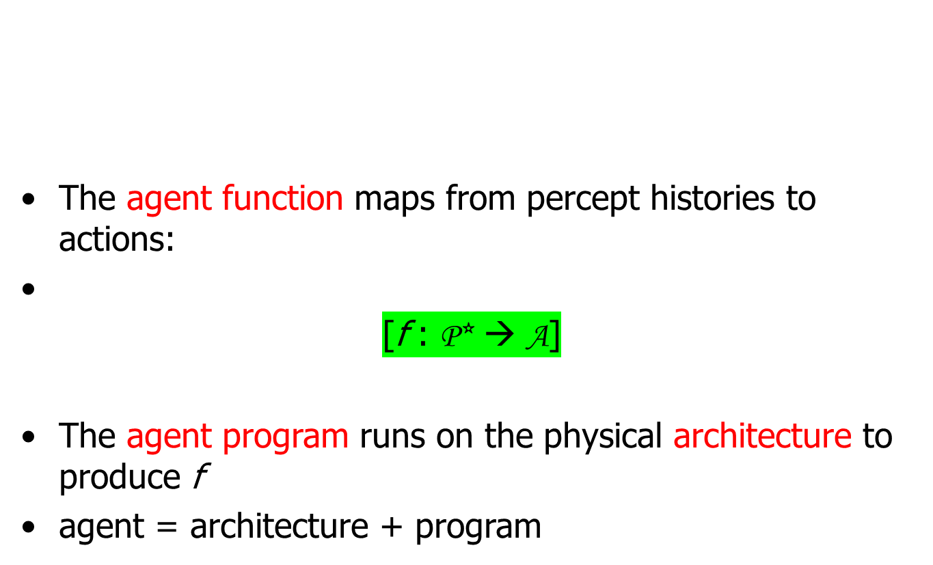

Slide 6
Agents and Environments
Example: Vacuum Cleaner World
  Two locations: squares A and B
  Perceives what square it is in
  Perceives if there is dirt in the current square
  Actions
    move left
    move right
    suck up the dirt
    do nothing
A
B

Slide 7
Agents and Environments
Agent Function: Vacuum Cleaner World
  If the current square is dirty, then suck, otherwise move to the other square
Percept Sequence | Action
[A, Clean] | Right
[A, Dirty] | Suck
[B, Clean] | Left
[B, Dirty] | Suck
[A, Clean], [A, Clean] | Right
[A, Clean], [A, Dirty] | Suck

Slide 8
Agents and Environments
But what is the right way to fill out the table?
  is the agent
    good or bad
    intelligent or stupid
  can it be implemented in a small program?
Function Reflex-Vacuum-Agent([location, status]) return an action
  if status == Dirty then return Suck
  else if location = A then return Right
  else if location = B then return Left

Slide 9
Good Behavior and Rationality
Rational Agent – an agent that does the “right” thing
  Every entry in the table for the agent function is filled out correctly
  Doing the right thing is better than doing the wrong thing
    What does it mean to do the right thing?

Slide 10
Good Behavior and Rationality
Performance Measure
  A scoring function for evaluating the environment space
Rational Agent – for each possible percept sequence, a rational agent should select an action that is expected to maximize its performance measure, given the evidence provided by the percept sequence and what ever built-in knowledge the agent has.

Slide 11
Good Behavior and Rationality
Rational != omniscient [সর্বজ্ঞ, সর্বদর্শী]
Rational != clairvoyant [আলোকদৃষ্টিসম্পন্ন]
Rational != successful [সফল, সার্থক, জয়যুক্ত]
Rational -> exploration, learning, autonomy

Slide 12
Rational agents
An agent should strive [attempt] to "do the right thing", based on what it can perceive and the actions it can perform. The right action is the one that will cause the agent to be most successful
Performance measure: An objective criterion for success of an agent's behavior
  E.g., performance measure of a vacuum-cleaner agent could be amount of dirt cleaned up, amount of time taken, amount of electricity consumed, amount of noise generated, etc.

Slide 13
Rational agents
Rational Agent: For each possible percept sequence, a rational agent should select an action that is expected to maximize its performance measure, given the evidence provided by the percept sequence and whatever built-in knowledge the agent has.

Slide 14
Rational agents
Rationality is distinct (different) from omniscience (all-knowing with infinite knowledge)
Agents can perform actions in order to modify future percepts so as to obtain useful information (information gathering, exploration)
An agent is autonomous if its behavior is determined by its own experience (with ability to learn and adapt)

Slide 15
PEAS
PEAS: Performance measure, Environment, Actuators, Sensors
Must first specify the setting for intelligent agent design
Consider, e.g., the task of designing an automated taxi driver:
  Performance measure
  Environment
  Actuators
  Sensors

Slide 16
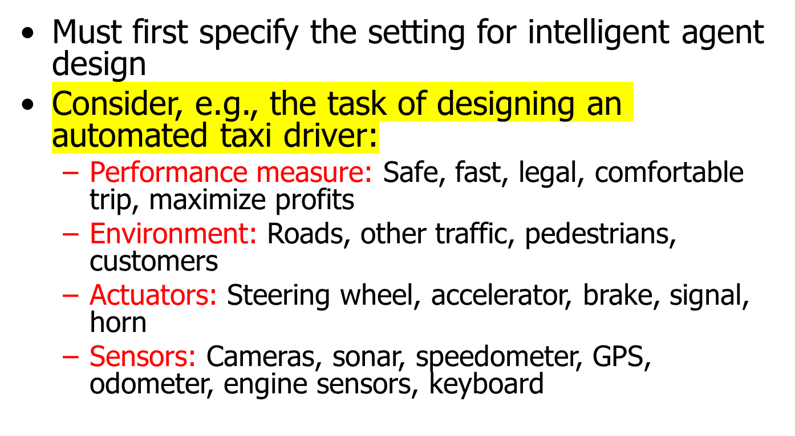
PEAS

Slide 17

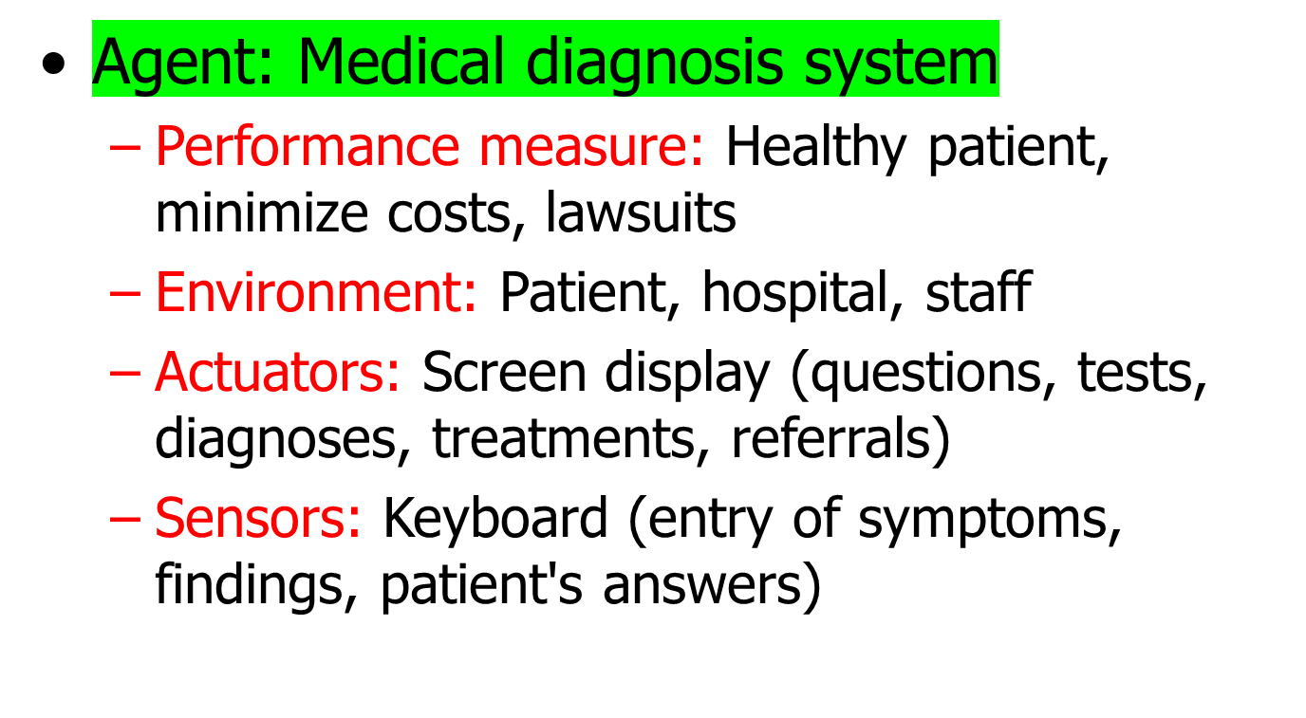

Slide 18
PEAS
Agent: Part-picking robot
  Performance measure: Percentage of parts in correct bins
  Environment: Conveyor belt with parts, bins
  Actuators: Jointed arm and hand
  Sensors: Camera, joint angle sensors

Slide 19
Agent: Interactive English tutor
  Performance measure: Maximize student's score on test
  Environment: Set of students
  Actuators: Screen display (exercises, suggestions, corrections)
  Sensors: Keyboard

Slide 20
The Nature of Environments
Task environments
  The “problems” to which a rational agent is the “solution”
PEAS
  Performance
  Environment
  Actuators
  Sensors

Slide 21

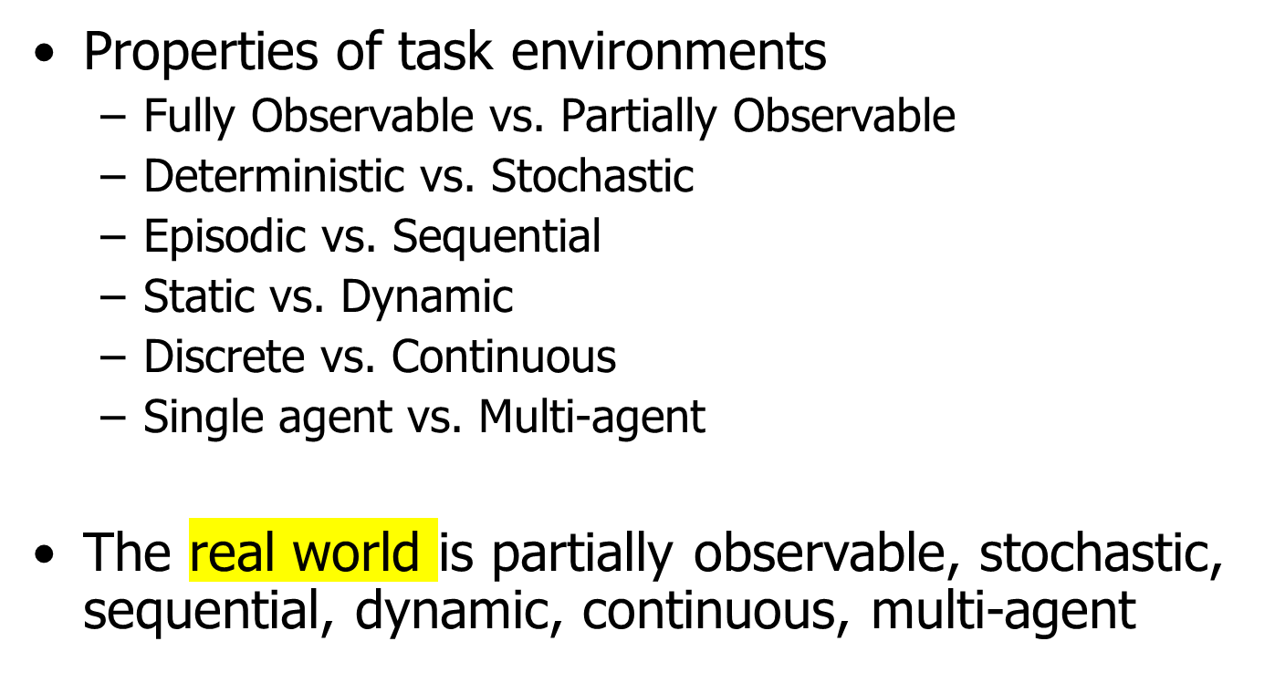

Slide 22
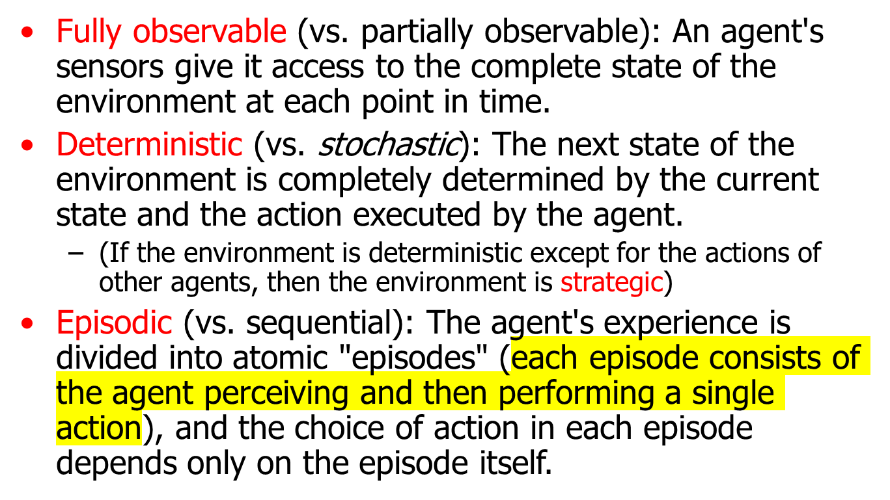
Environment types

Slide 23
Environment types
Chess with Chess without Taxi driving
a clock a clock
Fully observable Yes Yes No
Deterministic Strategic Strategic No
Episodic No No No
Static Semi Yes No
Discrete Yes Yes No
Single agent No No No
The environment type largely determines the agent design
The real world is (of course) partially observable, stochastic, sequential, dynamic, continuous, multi-agent

Slide 24
Agent functions and programs
An agent is completely specified by the agent function mapping percept sequences to actions
One agent function (or a small equivalence class) is rational
Aim: find a way to implement the rational agent function concisely

Slide 25
The Nature of Environments
Task environments
  The “problems” to which a rational agent is the “solution”
PEAS
  Performance
  Environment
  Actuators
  Sensors

Slide 26
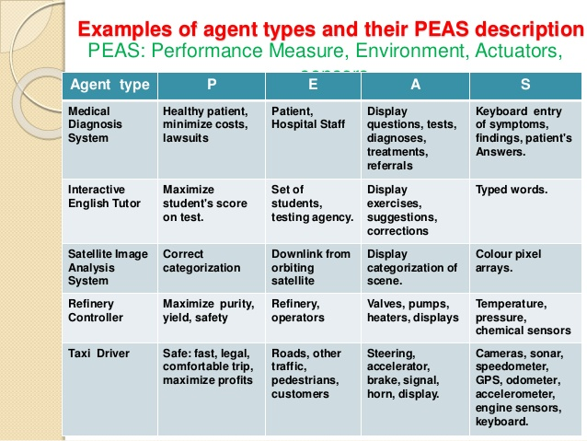


Slide 27
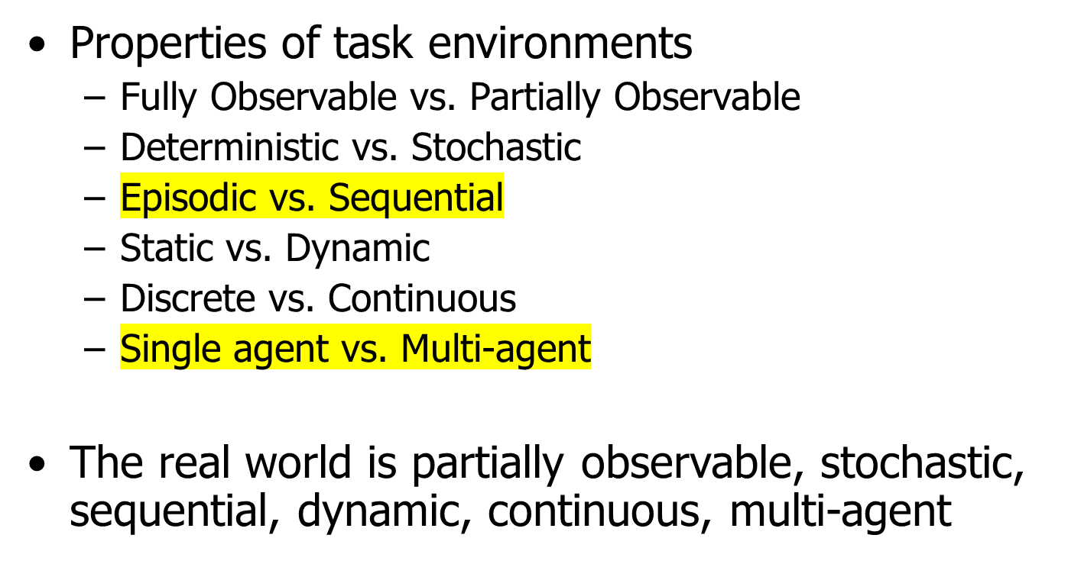
The Nature of Environments

Slide 28
The Nature of Environments
Examples
  Solitaire
  Backgammon
  Automated Taxi
  Mars Rover

Slide 29
The Structure of Agents
Agent = Architecture + Program
Basic algorithm for a rational agent
  While (true) do
    Get percept from sensors into memory
    Determine best action based on memory
    Record action in memory
    Perform action
Most AI programs are a variation of this theme

Slide 30
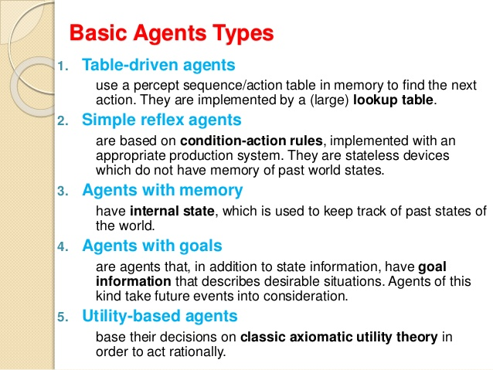

Slide 31
The Structure of Agents
Table Driven Agent
function Table-Driven-Agent (percept) return action
static: percepts, a sequence, initially empty
table, a table of actions, indexed by percept sequences, initially fully specified
append percept to the end of the table
action <- LOOKUP( percept, table )
return action

Slide 32
The Structure of Agents
Simple Reflex Agent
What the world
is like now
Sensors
Percepts
Environment
Condition-Action
Rules
What action I
should do now
Actions
Actuators

Slide 33
The Structure of Agents
Simple Reflex Agent
function Simple-Reflex-Agent (percept) return action
static: rules, a set of condition-action rules
state <- INTERPRET-INPUT( percept )
rule <- RULE-MATCH( state, rules )
action <- RULE-ACTION[ rule ]
return action

Slide 34
The Structure of Agents
Reflex Agent With State
What the world
is like now
Sensors
Percepts
State
How the world evolves
What my actions do
Environment
Condition-Action
Rules
What action I
should do now
Actions
Actuators

Slide 35
The Structure of Agents
Reflex Agent With State
function Reflex-Agent-With-State (percept) return action
static: state, a description of the current world state
rules, a set of condition-action rules
action, the most recent action, initially none
state <- UPDATE-STATE( state, action, percept )
rule <- RULE-MATCH( state, rules )
action <- RULE-ACTION[ rule ]
return action

Slide 36
The Structure of Agents
Goal Based Agent
What the world
is like now
Sensors
Percepts
State
How the world evolves
What my actions do
Environment
What it will be like
if I do action A
Goals
What action I
should do now
Actions
Actuators

Slide 37
The Structure of Agents
Utility Based Agent
What the world
is like now
Sensors
Percepts
State
How the world evolves
What it will be like
if I do action A
Environment
What my actions do
Utility
How happy I will be
in such a state
What action I
should do now
Actions
Actuators

Slide 38
The Structure of Agents
Learning Based Agent
Critic
(external
performance
standard)
Sensors
Percepts
feedback
Environment
changes
Learning
Element
Performance
Element
knowledge
learning goals
Actuators
Actions
Problem
Generator

